Slide 1



Slide 2
Problem Statement
The online hotel reservation channels have dramatically changed booking possibilities and customers’ behavior. A significant number of hotel reservations are called-off due to cancellations or no-shows. The typical reasons for cancellations include change of plans, scheduling conflicts, etc. This is often made easier by the option to do so free of charge or preferably at a low cost which is beneficial to hotel guests, but it is a less desirable and possibly revenue-diminishing factor for hotels to deal with. Predict if the customer is going to honor the reservation or cancel it

Slide 3
Agenda
01
02
03
04
05
Problem Statement
Base
Model
Model
Building
Implementation
Conclusion

Slide 4
Data Dictionary
1.) hotel - Hotel Type
2.) is_canceled (Target Variable) - Value indicating if the booking was canceled
3.) lead_time - Number of days that elapsed between the entering date of the booking into the PMS and the arrival date
4.) arrival_date_year - Year of arrival date
5.) arrival_date_month - Month of arrival date with 12 categories
6.) arrival_date_week_number - Week number of the arrival date
7.) arrival_date_day_of_month - Day of the month of the arrival date
8.) stays_in_weekend_nights - Number of weekend nights (Saturday or Sunday) the guest stayed or booked to stay at the hotel
9.) stays_in_week_nights - Number of week nights (Monday to Friday) the guest stayed or booked to stay at the hotel
10.) adults - Number of adults
11.) children - Number of children
12.) babies - Number of babies
13.) meal - Type of meal booked. Categories are presented in standard hospitality meal packages
14.) country - Country of origin. Categories are represented in the ISO 3155–3:2013 format
15.) market_segment - Market segment designation
16.) distribution_channel - Booking distribution channel
17.) is_repeated_guest - Value indicating if the booking name was from a repeated guest
18.) previous_cancellations - Number of previous bookings that were cancelled by the customer prior to the current booking
19.) previous_bookings_not_canceled - Number of previous bookings not cancelled by the customer prior to the current booking
20.) reserved_room_type - Code of room type reserved Code is presented instead of designation for anonymity reasons
21.) assigned_room_type - Code for the type of room assigned to the booking.Sometimes the assigned room type differs from the reserved room type due to hotel operation reasons (e.g. overbooking) or by customer request
22.) booking_changes - Number of changes/amendments made to the booking from the moment the booking was entered on the PMS
23.) deposit_type - Indication on if the customer made a deposit to guarantee the booking. This variable can assume three categories
24.) agent - ID of the travel agency that made the booking
25.) company - ID of the company/entity that made the booking or responsible for paying the booking. Note: ID is presented instead of designation for anonymity reasons
26.) days_in_waiting_list - Number of days the booking was in the waiting list before it was confirmed to the customer
27.) customer_type - Type of booking
28.) adr - Average Daily Rate
29.) required_car_parking_spaces - Number of car parking spaces required by the customer
30.) total_of_special_requests - Number of special requests made by the customer (e.g. twin bed or high floor)
31.) reservation_status_date - Date at which the last status was set

Slide 5
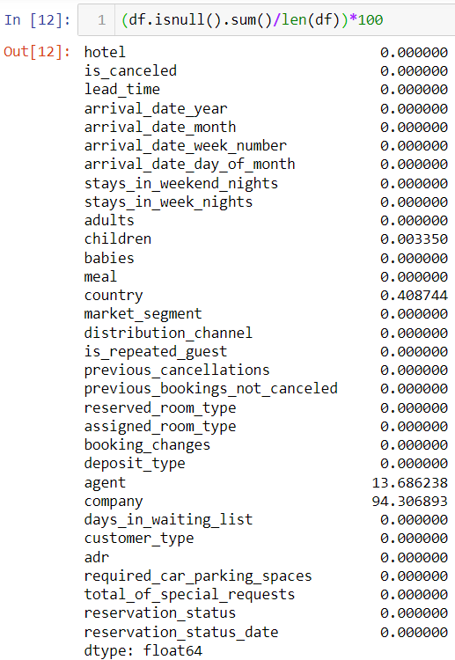
Data Pre-Processing
From the snippet present here, we found out that 4 columns, namely children, country, agent, and company have null values.
Null values in agent and company columns have been imputed with 0. We chose 0 as the agent id and company id as 0 ids in both columns may imply that that particular booking was done directly(in the case of the agent) or was not booked by a company(in the company id column)
Since the data is from a Portuguese hotel, we decided to impute the null values in the country column with ‘PRT’
Since most customers did not have a child accompanying them, we chose to impute nulls in this column with 0.

Slide 6
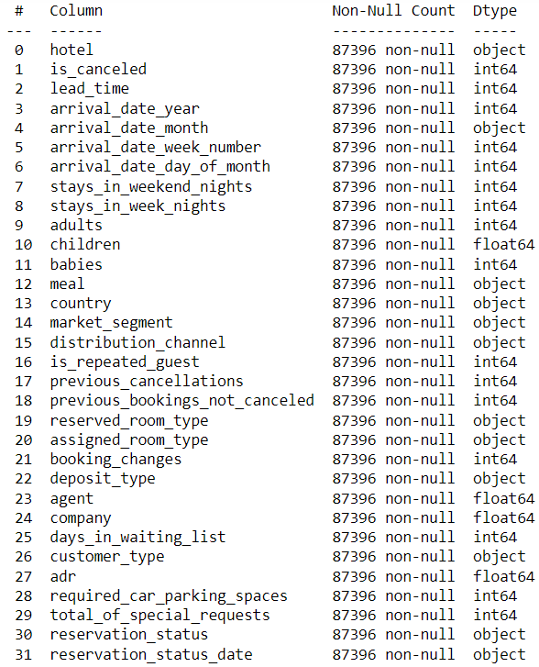
Implementation
Step 1:
Changing dtypes & Dropping duplicate rows
As we can see ‘is_canceled’,’arrival_date_year’,’children’,’is_repeated_guest’,’agent’,’company’,reservation_status_date’ have been assigned wrong datatypes. Hence we corrected the dtypes of these columns.
Also we found out that 31,994 rows were duplicate in our dataset. Therefore we decide to drop them.

Slide 7
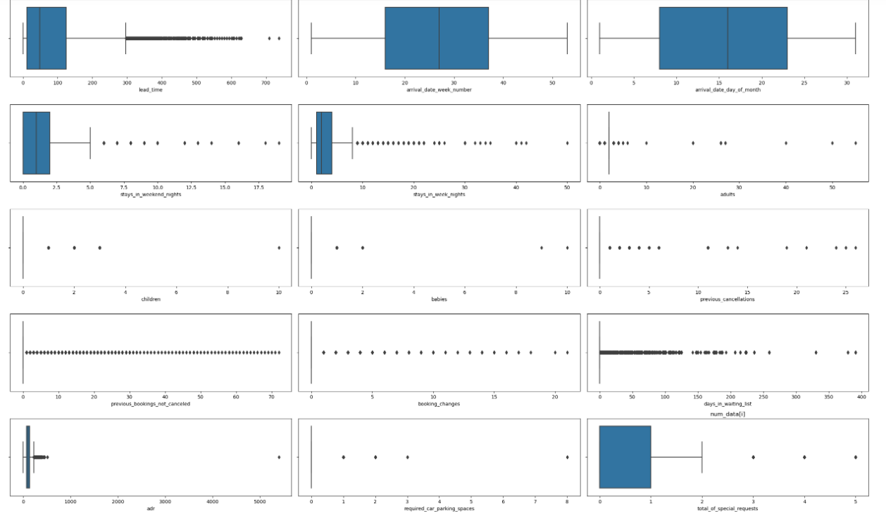
Step 2: Univariate Analysis
From the boxplots(apart from finding out the outliers) we find that:
1. Median of lead time column is somewhere close to 40 days
2. A lot of bookings are made from week numbers 17 to 38 which is understandable as these week numbers correspond to the start of Spring and end of Summer, respectively
3. Most bookings are neither made at the beginning nor at the end of the month
4. There have been instances where a booking has comprised of more than 50 adults(this is probably a corporate event)
5. Most tourists do not have children accompanying them but their have been instances where a booking comprised of 10 children
6. Most tourists do not have babies accompanying them but their have been instances where a booking comprised of 10 babies
7. There have been instances when a customer has cancelled more than 25 bookings, in the past
8. There are customers whi have made more than 20 changes to the booking
9. Though most of the bookings in the waiting list have been cleared in a day, their have been instances where a booking was in the waiting list for close to 400 days!
10. Most customers at the most make only 1 special request

Slide 8
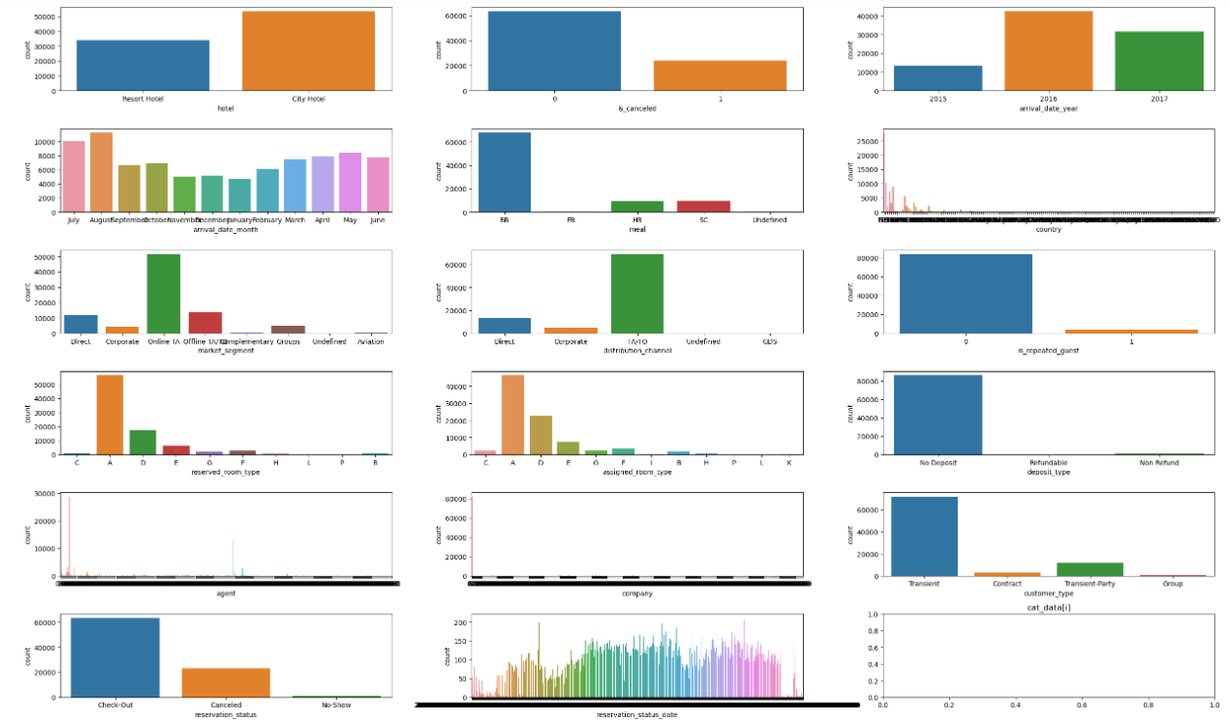
Step 2: Univariate Analysis
1. Majority of the bookings have been made in city hotel
2. Our target variable is imbalanced, so some balancing technique needs to be applied here
3. Majority of the data is from the year 2016
4. August is the busiest month for the business
5. Most people opt for breakfast in bed(BB)
6. Most guests are local i.e., Portuguese
7. Most guests have been acquired through online travel agents
8. Travel Agents/Tour Operators are the most preferred distribution channels to sell the rooms
9. Most guests are staying at the hotel for the first time
10. Most customers book the room at 0 price
11. Most guests opt for a short stay i.e. are transient guests
12. Travel agent with the id '9' books more rooms than
any other travel agent
13. Most rows in our data are not corporate events(as expected)
14. We also find out that there are undefined types in market segment type and distribution channel

Slide 9
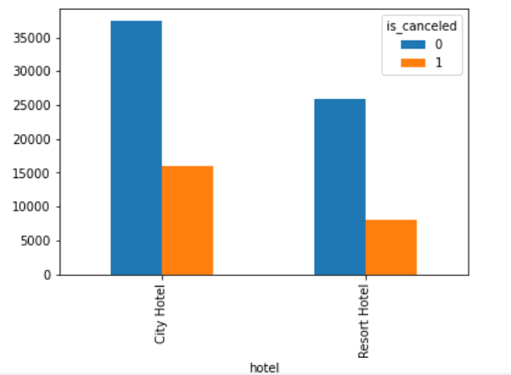
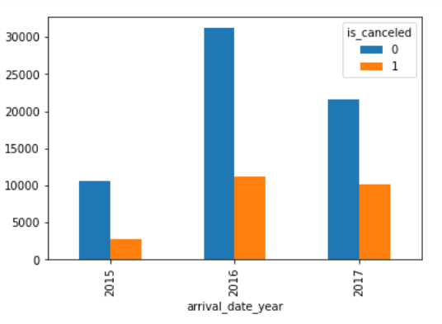
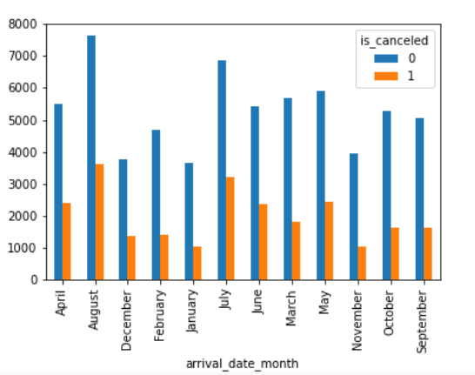
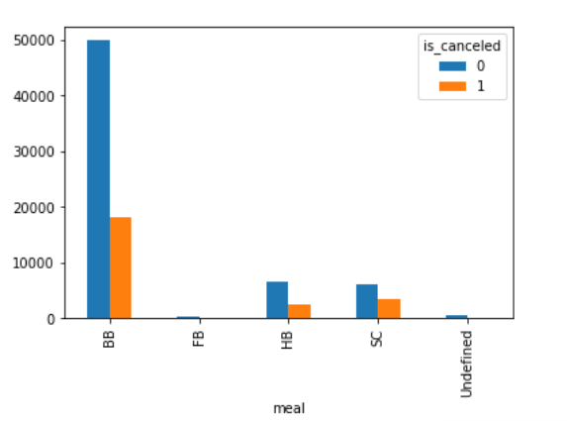
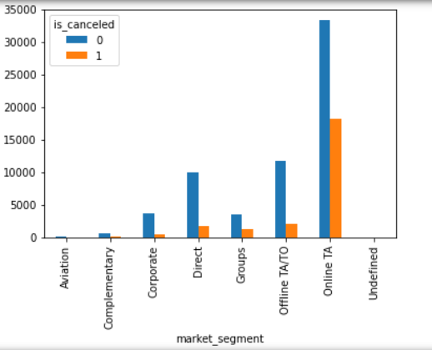
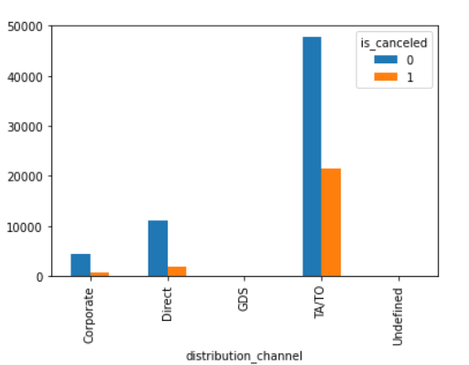
Step 3: Bivariate Analysis
1. City_hotel gets more cancellatations than Resort hotel
2. Since the number of bookings in 2016 and 2017 are higher than 2015, they automatically also have high number of cancellations than the latter.
3. August, July, May have high number of cancellations
4. Meal plan:
Meal plan BB has been ordered the most followed by HB,FB and SC ,in that order.
5. The top 5 nationality of our guests are:
PRT 48590
GBR 12129
FRA 10415
ESP 8568
DEU 7287
6. Since the online TA is the most prevalent subgroup in market segment, most number of cancellations also come from the same.

Slide 10
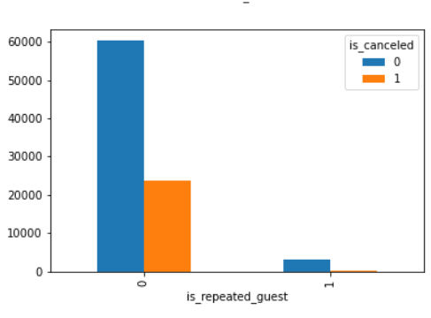
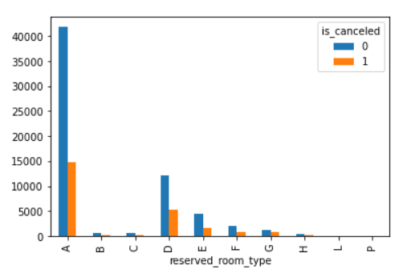
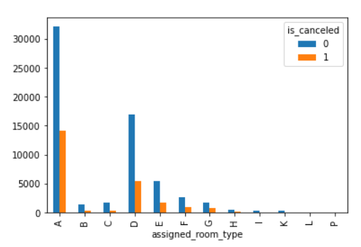
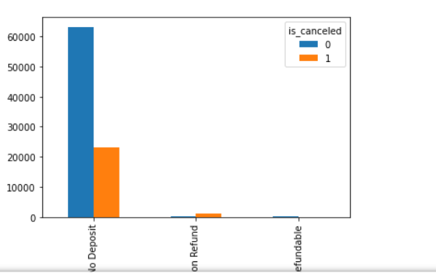
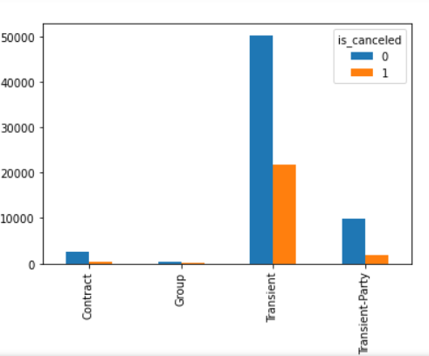
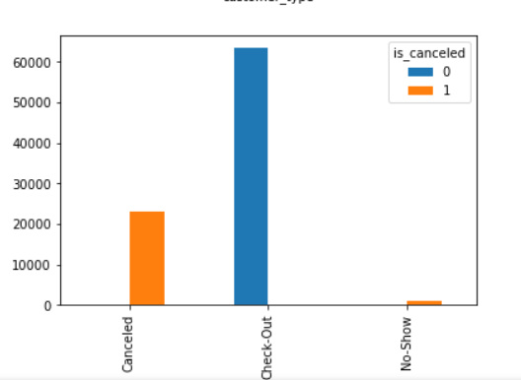
Step 3: Bivariate Analysis
7. Most guests are visiting the hotel for the first time.
8. The 4 most booked room types are:
A - 85601
D - 9173
E - 6497
F - 2890.
9. Most guests do not pay any deposit amount to the hotel. This might be another reason for the cancellations.
10. Again since, most guests are transient, the number of cancellations by this group is also pretty high.

Slide 11
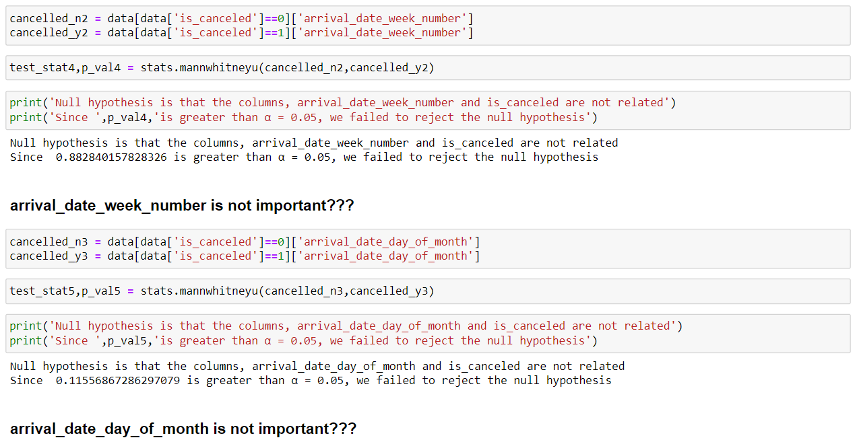
Step 4:
Significance of the variable using statistical tests
Since our target variable is categorical, ManWhitneyU test for Numerical vs Categorical and Chi2_square test for Categorical vs Categorical have been performed in order to analyse the significance of the independent variables.
From the above Statistical Hypothesis Tests, we conclude that the variables arrival_date_week_number and arrival_date_day_of_month are not significant with respect to our target variable.

Slide 12
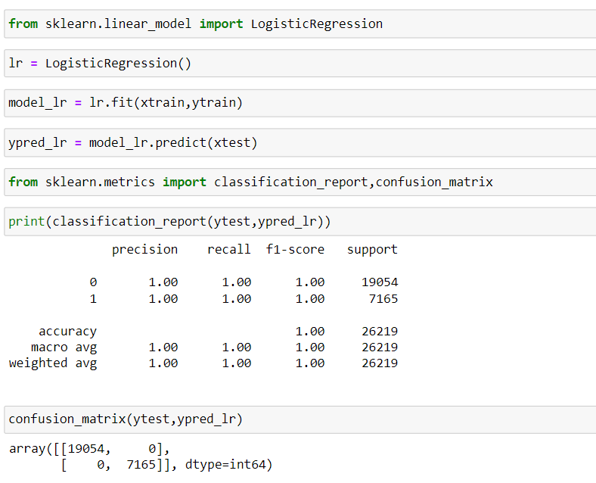
Base Model:
Logistic Regression:
Logistic Regression has been used to make the base model with a test size of 30%.
We can see that the confusion matrix predicts no false positives or false negative values by giving totally correct true positives and negatives.
The accuracy is thus seen to be 1 resulting in an overfit model.
The model overfitted because the number of features are huge when compared to the number of records.
Such models are practically not useful in the real world when different sorts of patterns are introduced to it.

Slide 13
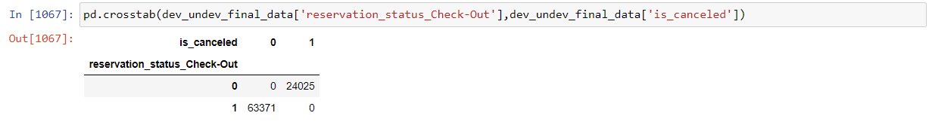
Inferences & Reasoning:
The major reason for the model to overfit is the curse of dimensionality.
There are close to 932 columns after the categorical variables are encoded, making the dataset too complex for logistic regression to solve.
We observe that the columns country, agent, and company have too many classes within them but only a few classes within these three variables are actually contributing to the data.
In countries, we consider only the top 12 countries while others are categorized as -1.
Similarly, agents’ top 12 and companies’ top 10 are taken while others are put as -1 for reducing the presence of too many encoded columns.
Once the categorical variables have been encoded we found that reservation_status_check_out is mutually exclusive of is_canceled (target variable) by using crosstab thus we removed this encoded column.

Slide 14
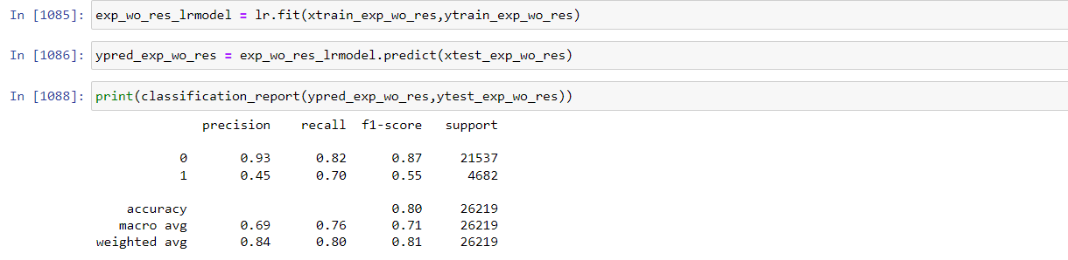
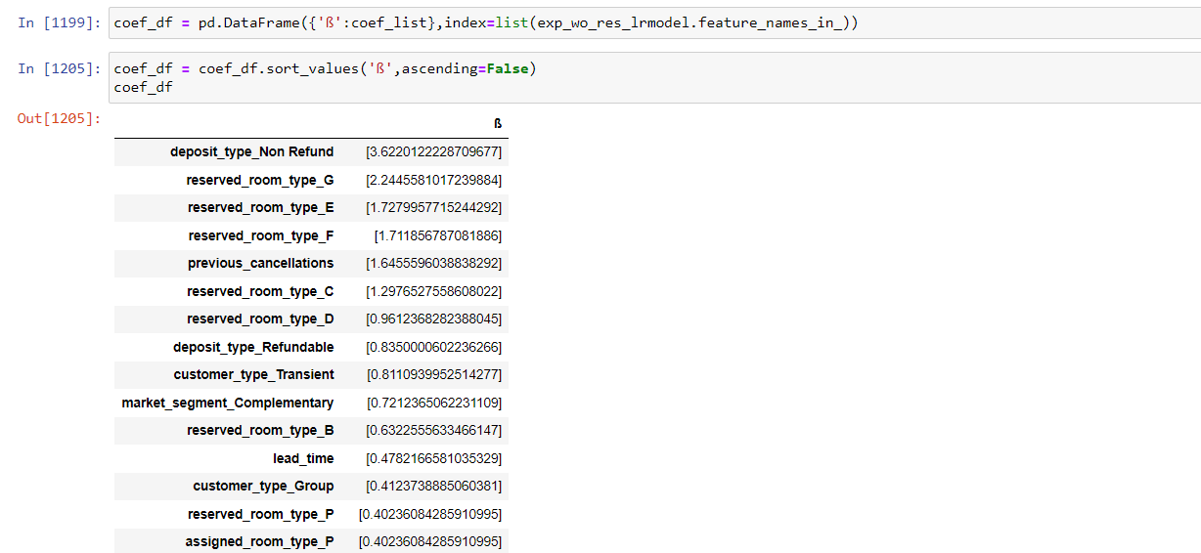
Logistic Regression
Logistic regression performs well after addressing the curse of dimensionality, with an accuracy rate of 80%. The f1_score for the class 1 is 0.55, and for the class 0, it is 0.87. The average f1_score for both classes is 0.71. One of the advantages of logistic regression is its explainability, which enables us to identify variables that strongly influence the target variable (is_canceled). The variables that have the most significant impact on our target variable are deposit_type_non-refund, reserved room types G, E, F, previous cancellations, and reserved room types C and D.

Slide 15
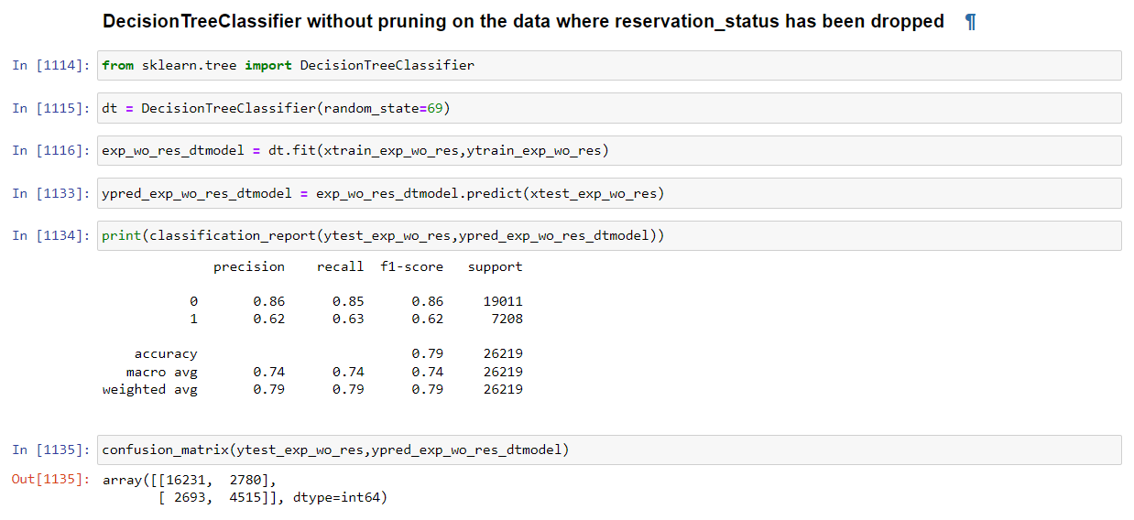
Decision Tree
The Decision Tree Classifier has yielded an accuracy rate of 79%, and the resulting confusion matrix predicts false positives and negatives, along with true positives and negatives, indicating its suitability for real-world scenarios. The f1_score for the majority class 0 is 0.86, while for the minority class 1, it is 0.62, resulting in a total f1_score of 0.74.

Slide 16
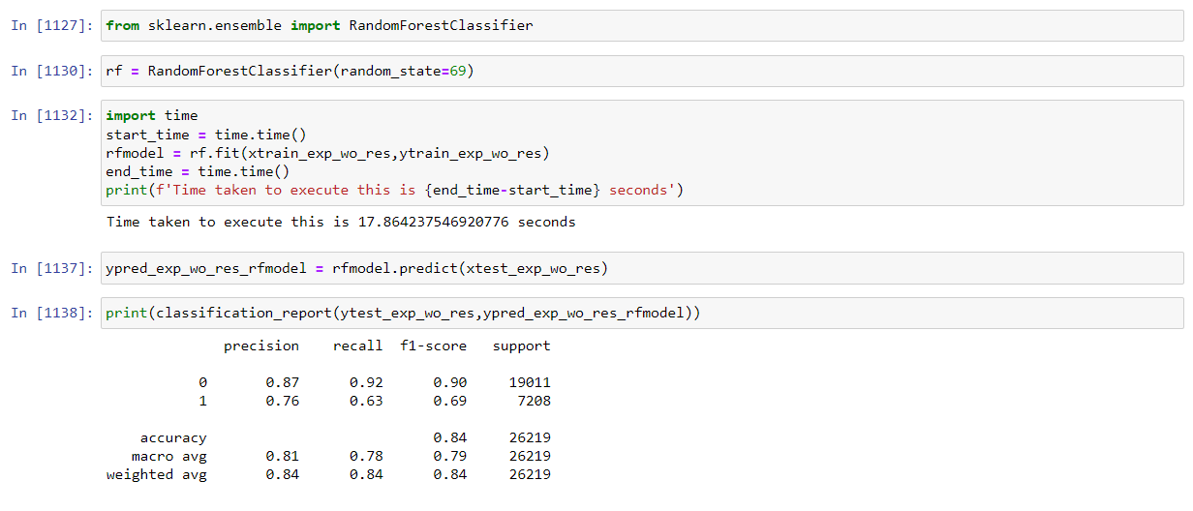
Random Forest Classifier
The Random Forest Classifier, an ensemble technique, achieved an accuracy rate of 84%, and both the individual recall and precision scores for the majority and minority classes are adequate for practical applications. The model yielded an f1_score of 0.9 for the class 0 and 0.69 for the class 1, with a total f1_score of 0.79. While the Random Forest Classifier performed the best among the models evaluated, the Logistic Regression model is still considered the best option for our problem statement due to its explainability factor.

Slide 17
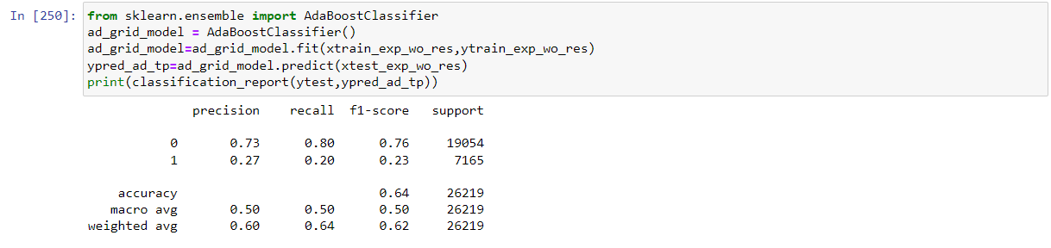
Ada Boost
AdaBoost is another ensemble technique that utilizes the boosting technique to enhance model performance. However, it only achieved an accuracy rate of 64%, and the model was unable to accurately predict the class 1, with a precision score of 0.27, a recall score of 0.20, and an f1_score of only 0.23. Therefore, this model is not suitable for making reliable predictions.

Slide 18
Conclusion:
In our problem statement, incorrectly predicting that a customer will cancel their reservation (a false positive) could damage the hotel's reputation if the room is given to another customer, resulting in a booking conflict. Conversely, incorrectly predicting that a customer will not cancel (a false negative) can lead to revenue loss for the hotel. Therefore, both recall and precision metrics are crucial.
As our classes are balanced based on the domain, we consider accuracy as our primary metric, followed by f1_score. After evaluating various models, we have found that Logistic Regression provides the highest accuracy of 80%, with proper explanations of the variables that affect the target variable. Therefore, it is our preferred model for this problem.

Slide 19
Thank you

